Slide 2
Real-Time Data Streaming with Azure Stream Analytics
Alexander Slotte - @alexslotte

Slide 3
Excella is an Agile technology firm and transformative partner to Washington, DC’s leading organizations. Since 2002, federal agencies, prominent brands and trailblazing non-profits have turned to Excella to transform bold ideas into elegant technology solutions. We believe technology exists to solve challenges and evolve thinking – we help organizations harness this power to make real progress. Learn more at www.excella.com.

Slide 4
8 reasons to stay awake
Azure Stream Analytics
Azure EventHubs
Azure Service Bus
Azure Logic App
Azure Cognitive Services
Twitter Streaming API
Power BI
Raspberry PI
Notes:
Notes here:

Slide 5
What is Real Time Stream Processing?

Slide 6






Slide 7
What is a stream?
Continuous
Stems from multiple sources
Small (Kb)
Timestamp/value

Slide 8
Batch vs Stream Processing
 | Batch Processing | Stream Processing
Data Volume | Large volumes | Small volumes
Query Processing | Entire dataset | Subset of data
Query Latency | Minutes to hours | Milliseconds to seconds
Data Insight | Processed hourly to daily | Near real-time insights

Slide 9
Technologies

Slide 10
Streaming Technologies
 | Azure Stream Analytics | HDInsight with Spark Streaming | Apache Spark in Azure Databricks | HDInsight with Storm
Programmability | ASQL, JavaScript | Scala, Python, Java | Scala, Python, Java, R | Java, C#
Programming paradigm | Declarative | Declarative and Imperative | Declarative and I mperative | Imperative
Pricing model | Streaming units | Per cluster hour | Databricks units | Per cluster hour
*Azure Functions
*Azure WebJobs

Slide 11
Azure Stream Analytics

Slide 12
Azure Stream Analytics

Slide 13




Ingress

Slide 14






Egress

Slide 15
Temporal Windows

Slide 16
Tumbling window
GROUP BY TumblingWindow(minute, 1)

Slide 17
Hopping window
GROUP BY HoppingWindow(Duration(minute, 1), Hop(second, 5))

Slide 18
Sliding window
GROUP BY SlidingWindow(seconds, 10) HAVING COUNT(*) > 10

Slide 19
Temporal SQL

Slide 20
Azure Stream Analytics - SQL
SELECT *
INTO output
FROM input
GROUP BY TumblingWindow(minute, 1)

Slide 21
Built-In Functions
Analytic LAG
ISFIRST
FIRST
ISLAST
LAST
ANOMOLYDETECTION
Array Functions
GETARRAYLENGTH
GETARRAYELEMENT
GETARRAYELEMENTS
Conversion CAST
GETTYPE
TRY_CAST
Geo Spatial
CREATELINESTRING
CREATEPOINT
CREATEPOLYGON
ST_DISTANCE
ST_OVERLAPS
ST_INTERSECT
ST_WITHIN

Slide 22
Performance and Scaling

Slide 23
Scaling and Pricing
CPU + Memory + Storage => Streaming units (SU)
$0.11 h per SU = $82/month
Max 192 SU per job
Query Performance

Slide 24
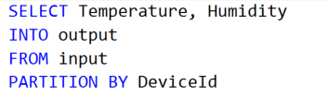
Performance
Use PARTITION BY to run in parallel
An EvenHub has 2-32 partitions
Not all jobs are possible to run in parallel

Slide 25
Demo(s)

Slide 26
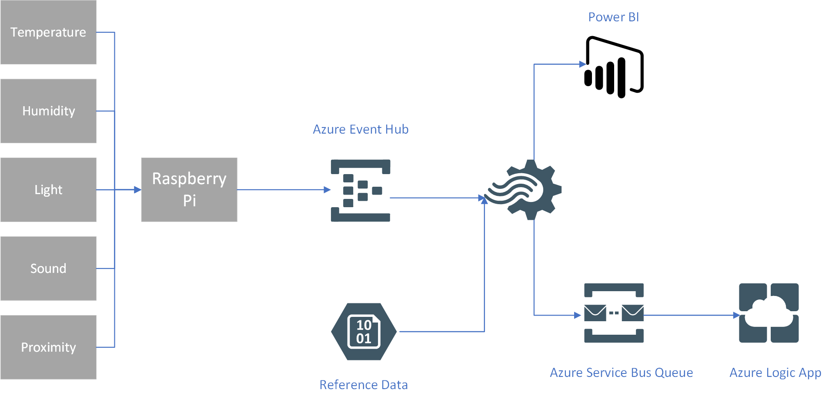
Raspberry Pi – IoT Data

Slide 27
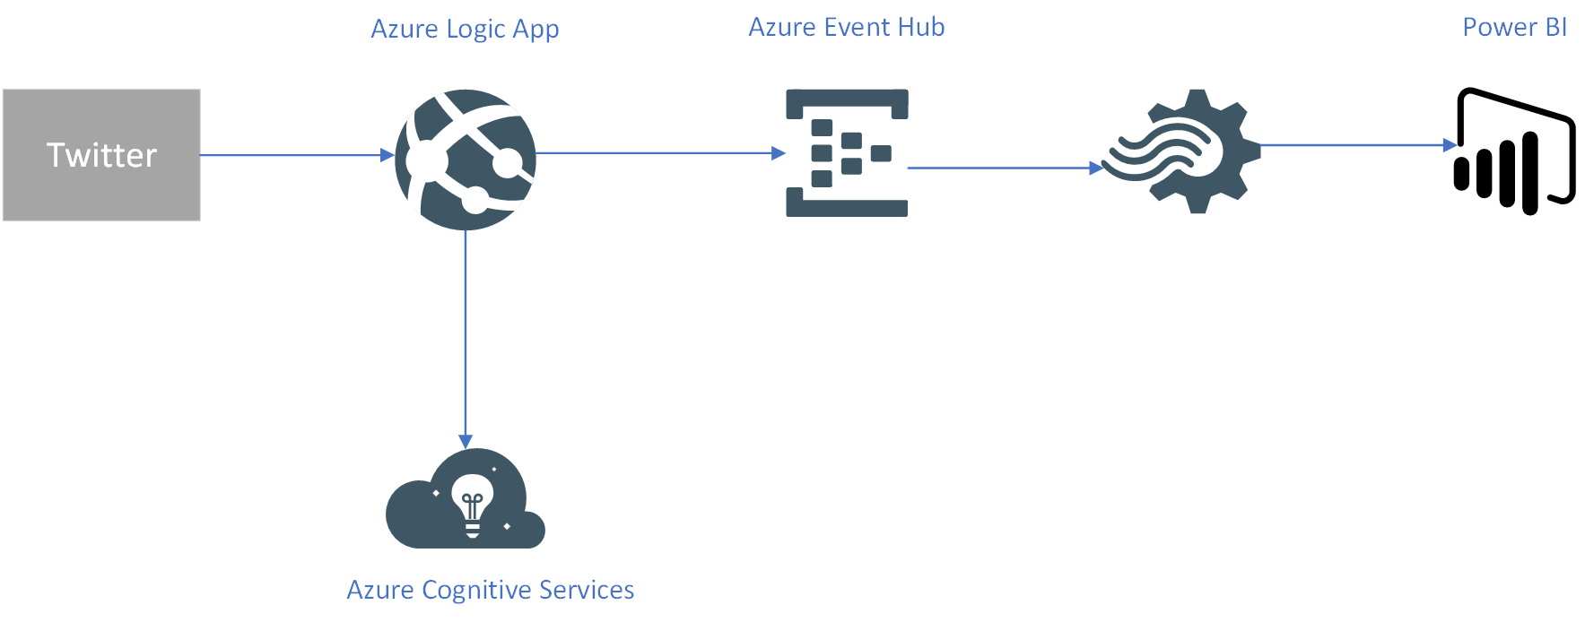
Twitter – Sentiment Analysis

Slide 28
Questions?
info@excella.com | 703-840-8600
www.excella.com

